Slide 1
Options on Stock Indices and Currencies
Chapter 15

Slide 2
Index Options
The most popular indices underlying options in the U.S. are
  The S&P 100 Index (OEX and XEO)
  The S&P 500 Index (SPX)
  The Dow Jones Index times 0.01 (DJX)
  The Nasdaq 100 Index (NDX)
Contracts are on 100 times index; they are settled in cash; OEX is American; the XEO and all other options are European.

Slide 3
Index Option Example
Consider a call option on an index with a strike price of 1260
Suppose 1 contract is exercised when the index level is 1280
What is the payoff?

Slide 4
Using Index Options for Portfolio Insurance
Suppose the value of the index is S₀ and the strike price is K
If a portfolio has a β of 1.0, the portfolio insurance is obtained by buying 1 put option contract on the index for each 100S₀ dollars held
If the β is not 1.0, the portfolio manager buys β put options for each 100S₀ dollars held
In both cases, K is chosen to give the appropriate insurance level

Slide 5
Example 1
Portfolio has a beta of 1.0
It is currently worth $500,000
The index currently stands at 1000
What trade is necessary to provide insurance against the portfolio value falling below $450,000?

Slide 6
Example 2
Portfolio has a beta of 2.0
It is currently worth $500,000 and index stands at 1000
The risk-free rate is 12% per annum
The dividend yield on both the portfolio and the index is 4%
How many put option contracts should be purchased for portfolio insurance?

Slide 7
Calculating Relation Between Index Level and Portfolio Value in 3 months
If index rises to 1040, it provides a 40/1000 or 4% return in 3 months
Total return (incl. dividends)=5%
Excess return over risk-free rate=2%
Excess return for portfolio=4%
Increase in Portfolio Value=4+3–1=6%
Portfolio value=$530,000

Slide 8
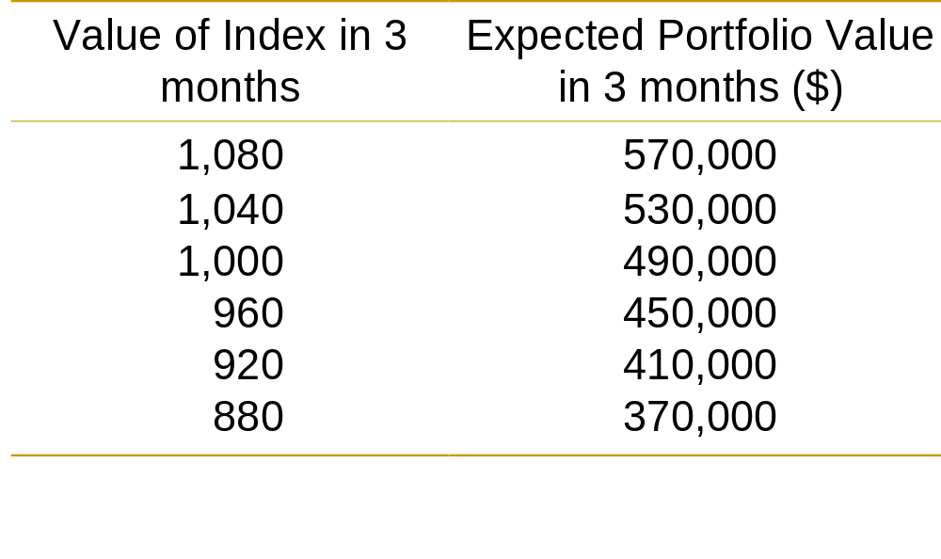
Determining the Strike Price (Table 15.2, page 330)
An option with a strike price of 960 will provide protection against a 10% decline in the portfolio value

Slide 9
Currency Options
Currency options trade on the NASDAQ OMX
There also exists an active over-the-counter (OTC) market
Currency options are used by corporations to buy insurance when they have an FX exposure

Slide 10
Range Forward Contracts
Have the effect of ensuring that the exchange rate paid or received will lie within a certain range
When currency is to be paid it involves selling a put with strike K₁ and buying a call with strike K₂
When currency is to be received it involves buying a put with strike K₁ and selling a call with strike K₂
Normally the price of the put equals the price of the call

Slide 11
Range Forward Contract continued
Figure 15.1, page 332
Payoff
Payoff
Asset Price
K₁
K₂
K₁
K₂
Asset Price
Short Position
Long Position

Slide 12
European Options on Stocks with Known Dividend Yields
We get the same probability distribution for the stock price at time T in each of the following cases:
1. The stock starts at price S₀ and provides a dividend yield = q
2. The stock starts at price S₀e^{–qT} and provides no income

Slide 13
European Options on Stocks
Paying Dividend Yield continued
We can value European options by reducing the stock price to S₀e^{–qT} and then behaving as though there is no dividend

Slide 14
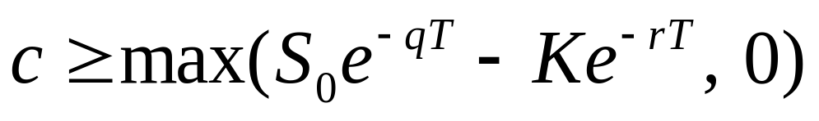
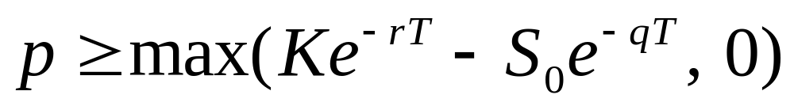
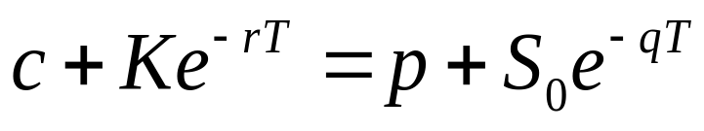
Extension of Chapter 10 Results
(Equations 15.1 to 15.3, page 334)
Lower Bound for calls:
Lower Bound for puts
Put Call Parity

Slide 15
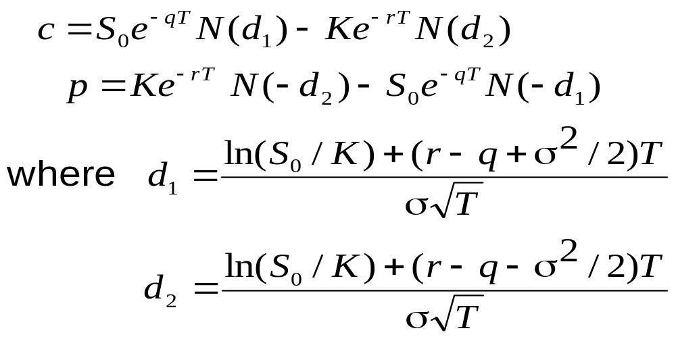
Extension of Chapter 13 Results (Equations 15.4 and 15.5, page 335)

Slide 16
Valuing European Index Options
We can use the formula for an option on a stock paying a continuous dividend yield
Set S₀ = current index level
Set q = average dividend yield expected during the life of the option

Slide 17
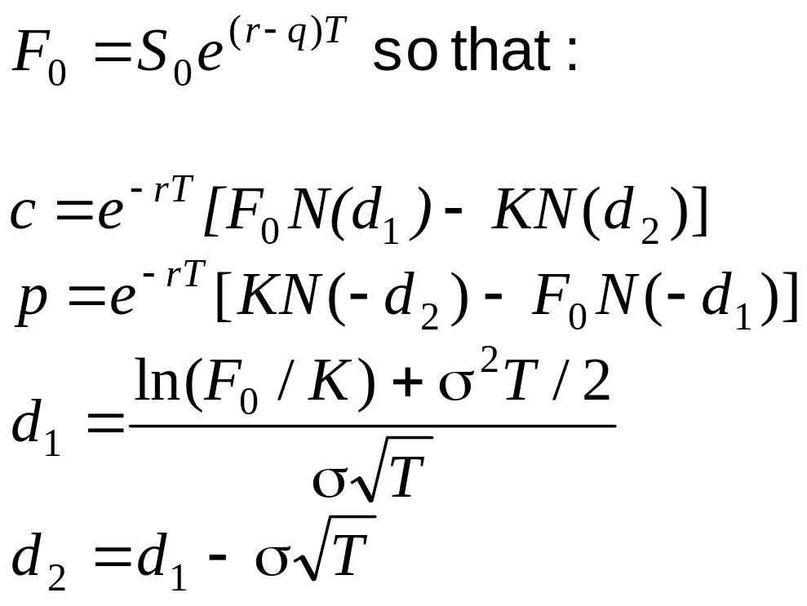
Using Forward/Futures Index Prices (equations 15.6 and 15.7, page 337)

Slide 18
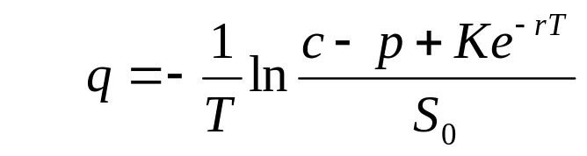
Implied Dividend Yields
From European calls and puts with the same strike price and time to maturity
These formulas allow term structures of dividend yields to be
OTC European options are typically valued using the forward prices (Estimates of q are not then required)
American options require the dividend yield term structure

Slide 19
Currency Options: The Foreign Interest Rate
We denote the foreign interest rate by r_{f}
The return measured in the domestic currency from investing in the foreign currency is r_{f} times the value of the investment
This shows that the foreign currency provides a yield at rate r_{f}

Slide 20
Valuing European Currency Options
We can use the formula for an option on a stock paying a continuous dividend yield :
    Set S₀ = current exchange rate
    Set q = r_{ƒ}

Slide 21
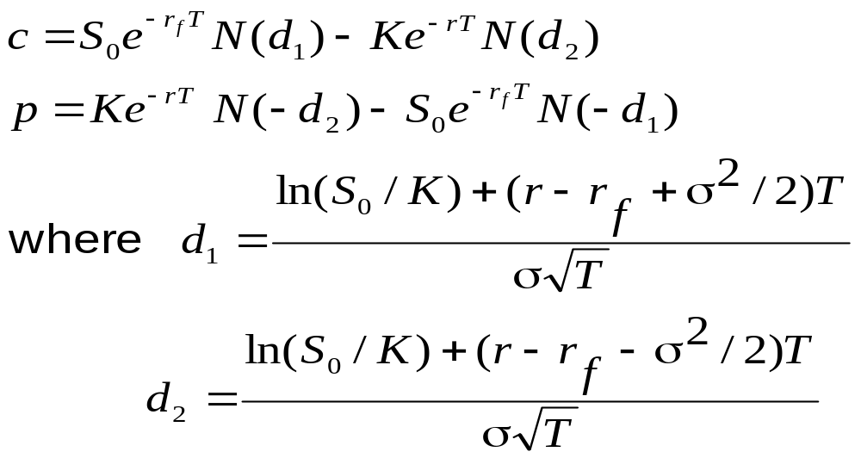
Formulas for European Currency Options
(Equations 15.8 and 15.9 page 338)

Slide 22
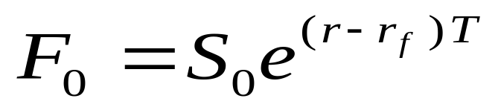
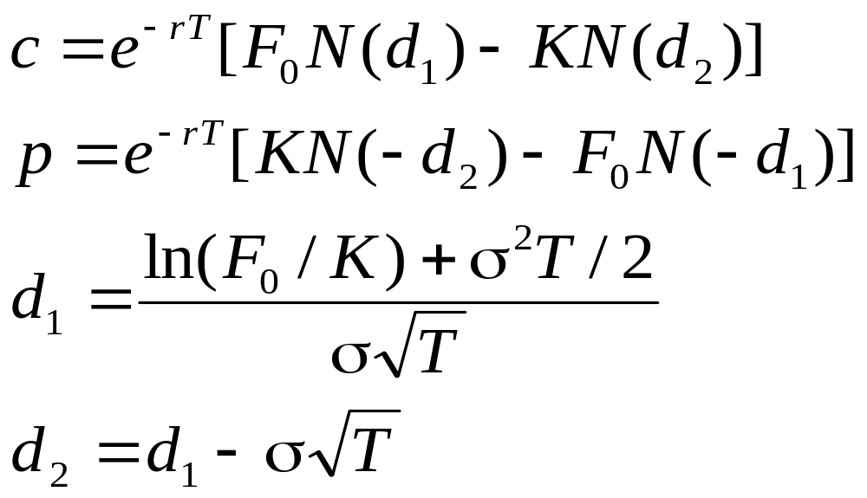
Using Forward/Futures Exchange Rates
(Equations 15.10 and 15.11, page 339)
Using

Slide 23
The Binomial Model for American Options
S₀u
ƒ_{u}
p
S₀
ƒ
S₀d
ƒ_{d}
(1 – p )
        f = e^{-rΔt}[pf_{u}+(1– p)f_{d} ]

Slide 24
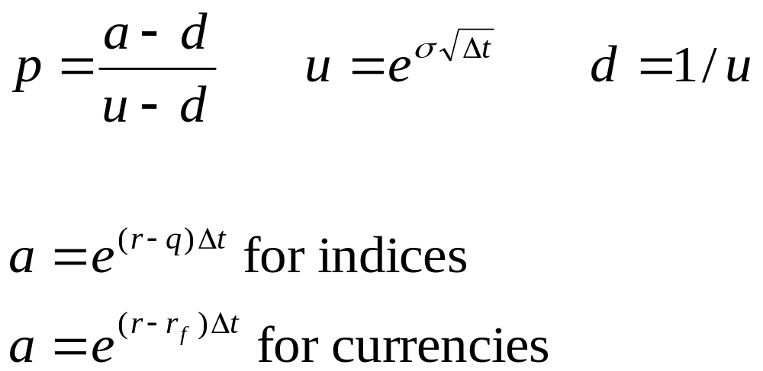
The Binomial Model continued

